Slide 1
Towards a Secure, Sustainable Energy Future:
The Role of Cyber security and Emerging Technologies
Stuart Okin, Director of Cyber Regulation and Emerging Technologies

Slide 2




Office of Gas and Electricity Markets
Great Britain’s energy regulator (gas and electricity)
Cyber Strategy & Policy
Cyber Investments
Assurance and Response
Guidance & Monitoring
Emerging Technologies
Consumer protection
Net zero transition
Economic growth
Investment
As Great Britain digitalises and transforms energy systems, we need to ensure they are resilient against cyber risks and use AI innovatively and safely.
  RIIO2 (transmission) / ED2 (distribution) -We have allocated £1.7b for operations, staffing and Cyber, technology and control room upgrades
  RIIO3 – £1.2b / ED3 – To be determined
1
NIS Regulation
Act, Licencing & Codes
2
3
4
Set and enforce regulations & license conditions
  Under NIS - 42 deep inspections, issuing £30m financial settlement on Operators of Essential Services (OES), for not having appropriate and proportionate risk measures in place for Cyber and technology resilience
Accelerate OES (CNI) cyber and technology resilience improvement
Be ready for Cyber Security Resilience Bill
Operationalise wider energy sector cyber and technology resilience improvement
Support energy emerging technology
Continuous improvement

Slide 3

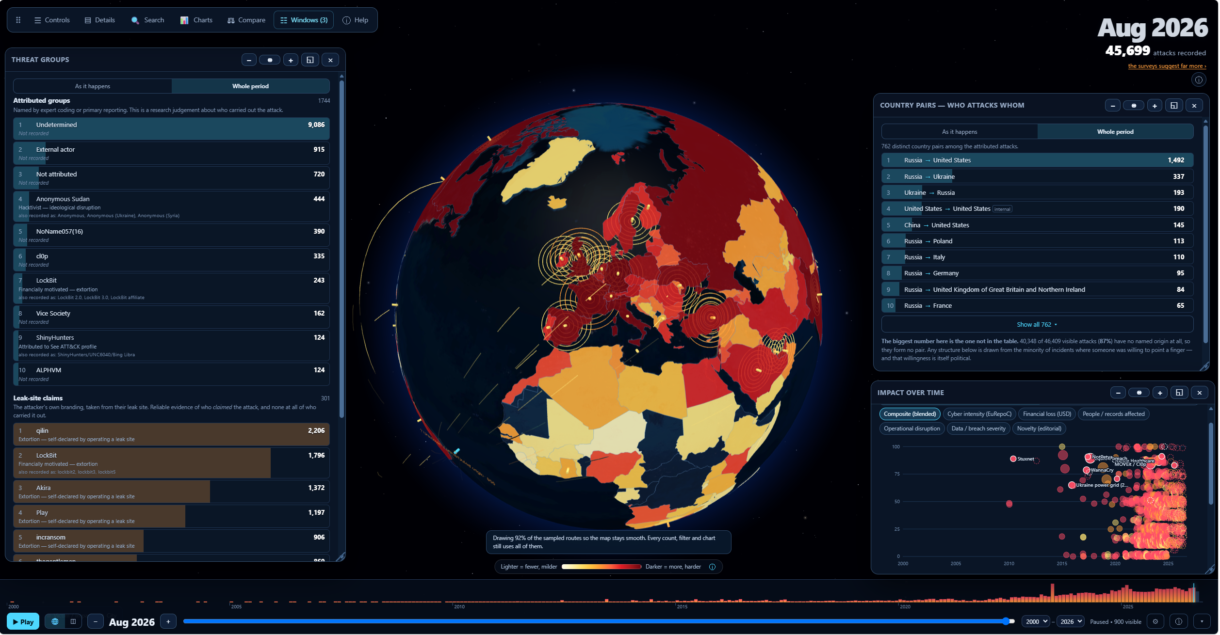
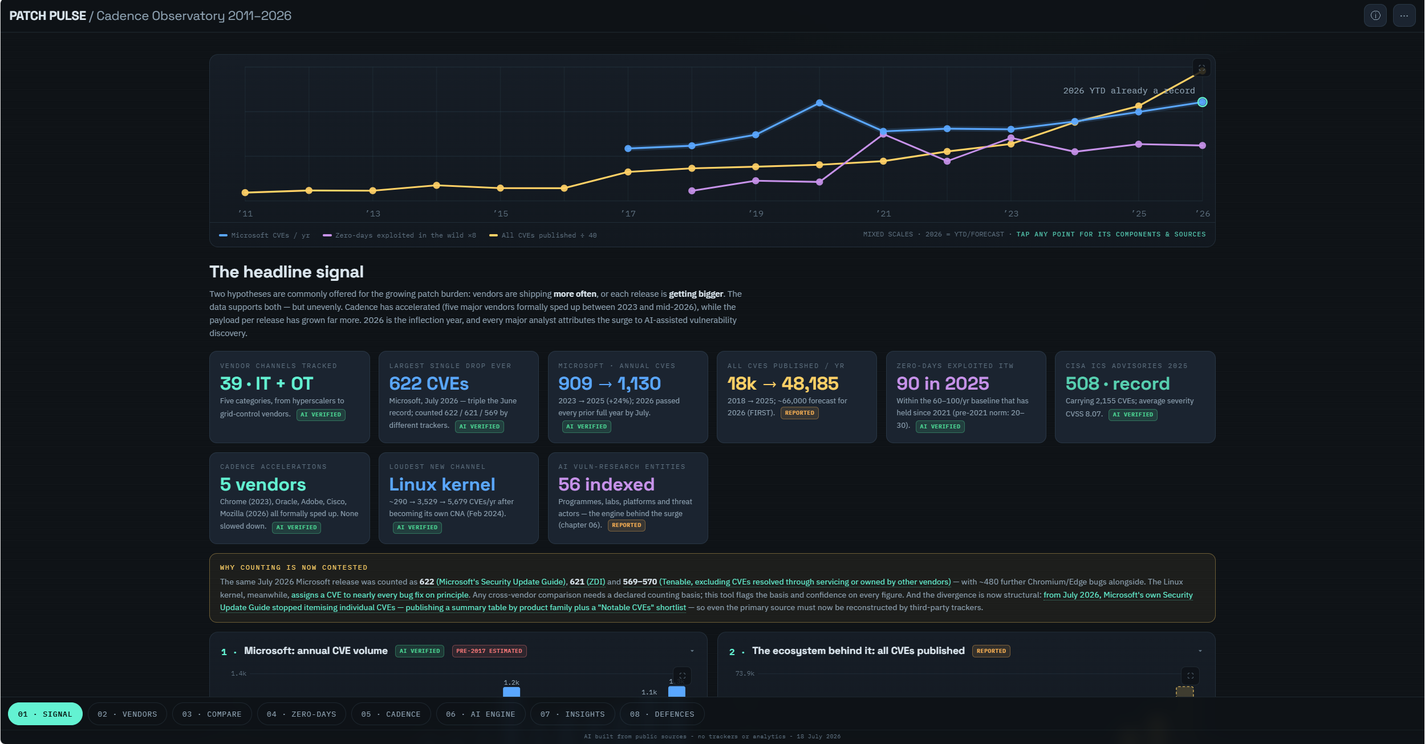
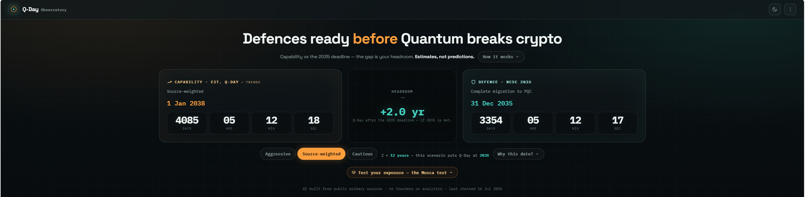
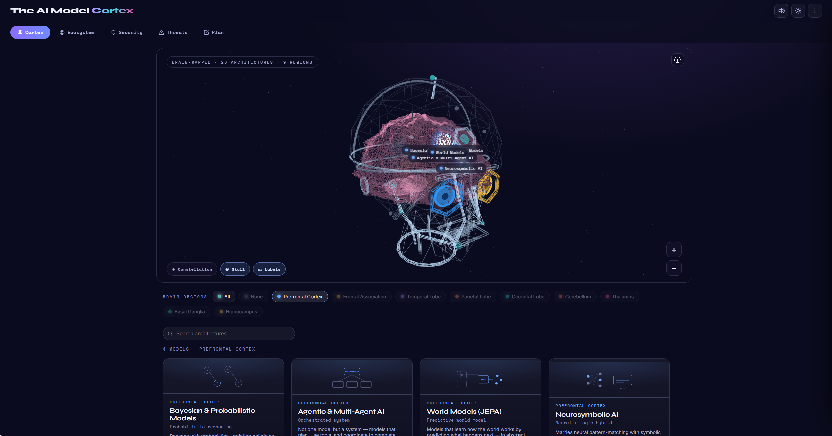
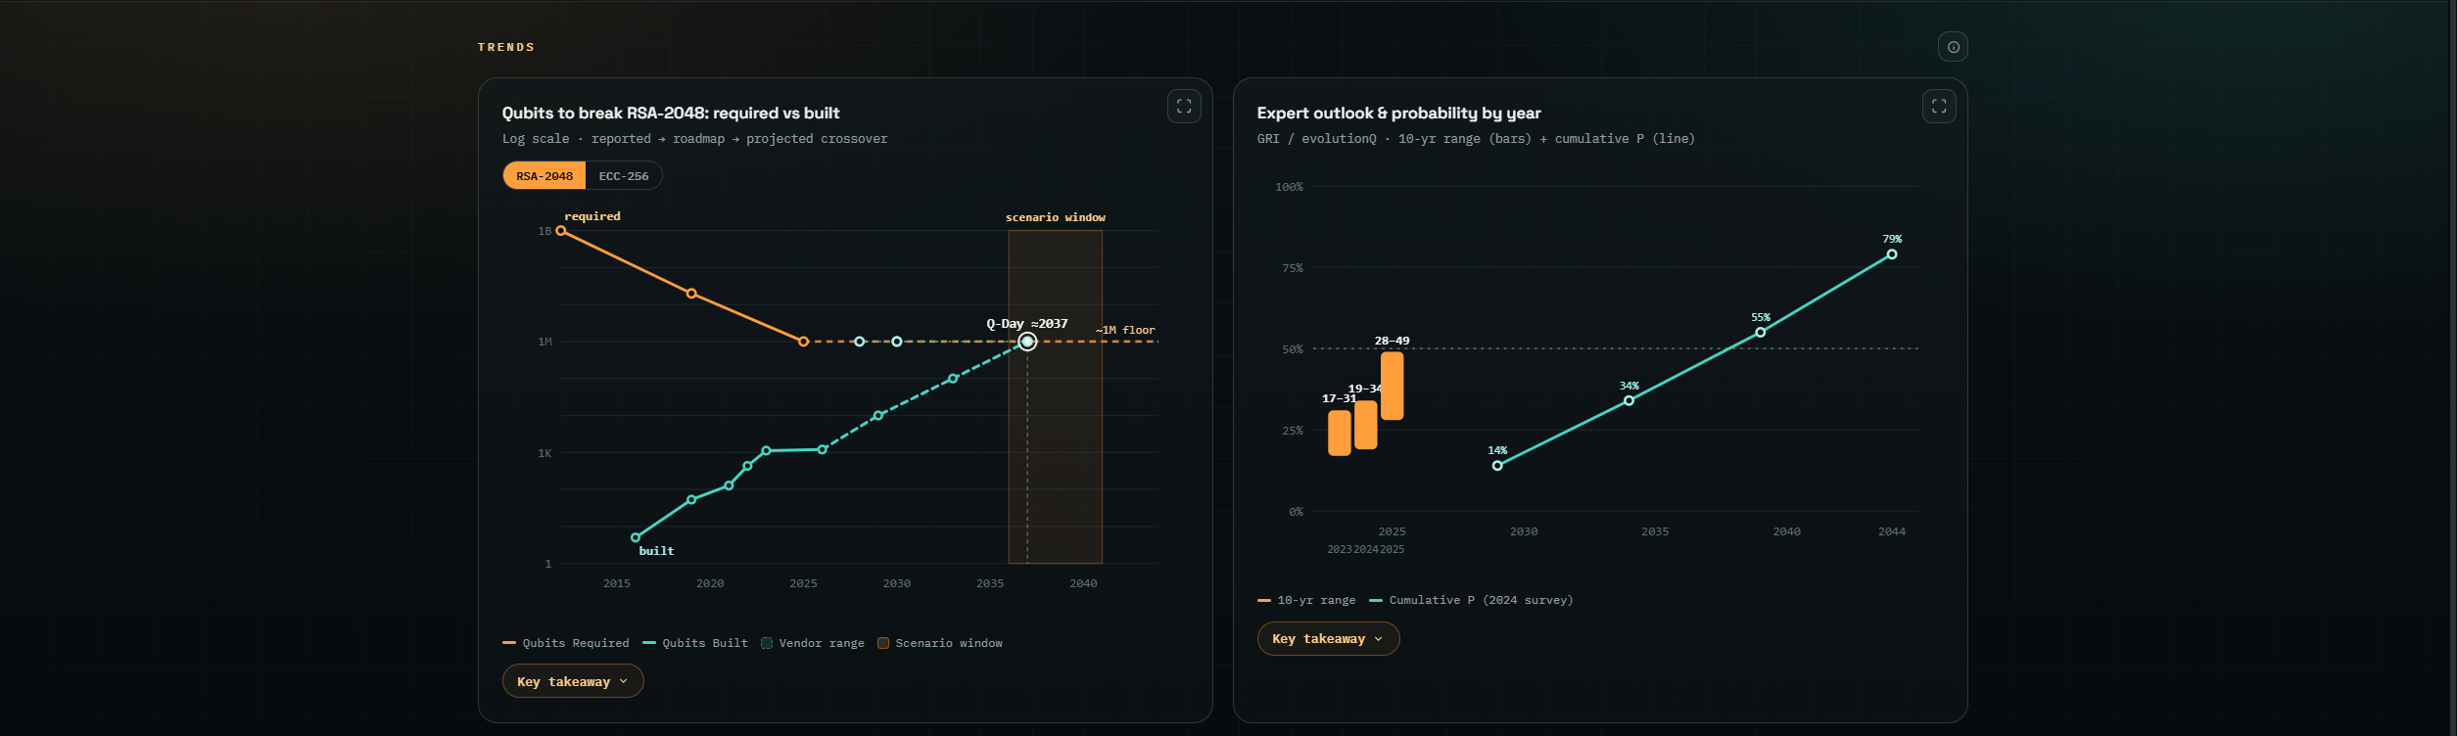
This time is yours……

Slide 4
Stuart Okin, Director of Cyber Regulation and Emerging Technologies - stuart.okin@ofgem.gov.uk

